Slide 1
FLIGHT PRICE PREDICTION

Slide 2
Problem Statement
1- Anyone who has booked a flight ticket knows how unexpectedly the prices vary. The cheapest available ticket on a given flight gets more and less expensive over time. This usually happens as an attempt to maximize revenue based on-
a-Time of purchase patterns (making sure last-minute purchases are expensive)
b- Keeping the flight as full as they want it (raising prices on a flight which is filling up in order to reduce sales and hold back inventory for those expensive last-minute expensive purchases)
2- So, you have to work on a project where you collect data of flight fares with other features and work to make a model to predict fares of flights.

Slide 3
Introduction
1- The data consists of two sets, i.e- Training dataset and Testing dataset.
2- Training dataset is of the year 2021collected from various websites.
3-The collected flight data contains source to destination of some major cities.
4- The dataset consists of different columns that affects the price of tickets.
5-The testing dataset consists of similar features except the price feature.
6-Based on machine learning model the price feature of testing dataset is predicted.

Slide 4
Exploratory Data Analysis
1- Use of Seaborn and Matplotlib library is done to find out the insights of the given data.
2- Barplot, Scatterplot, heatmaps are used to get out the valuable information.

Slide 5
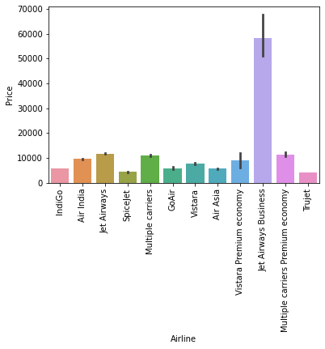
1- Airline vs Prices
Obs-
1-Jet Airways Business have the highest ticket price, followed by Multiple Carriers Premium Economy and Jet Airways.
2-Air India have higher prices than Indigo.
3- Spice Jet, GoAir and Air Asia have similar price ranges.
4- TruJet have the least prices.

Slide 6
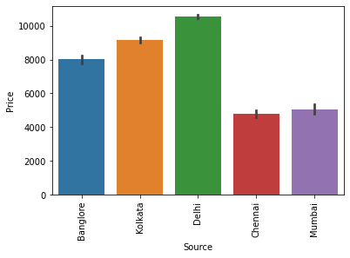
2-Source vs Prices
Obs-
1- Tickets from Delhi have highest price ranges followed by Kolkata and Bangalore.
2- Then followed by Mumbai.
3- Tickets from Chennai have the least prices.

Slide 7
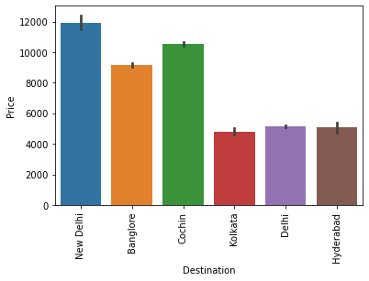
3-Destination vs Prices
Obs-
1-Tickets with NewDelhi as destination have highest prices followed by Coachin and Bangalore.
2- Delhi and Hyderabad have similar price range.
3-Tickets with Kolkata as destination have lowest prices among these destinations.

Slide 8
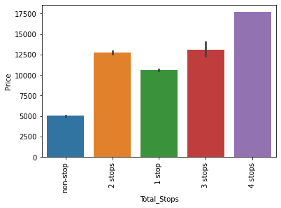
4-Total stops vs Price
Obs-
1-higher the no. of stops in a route , the higher the price of tickets.

Slide 9
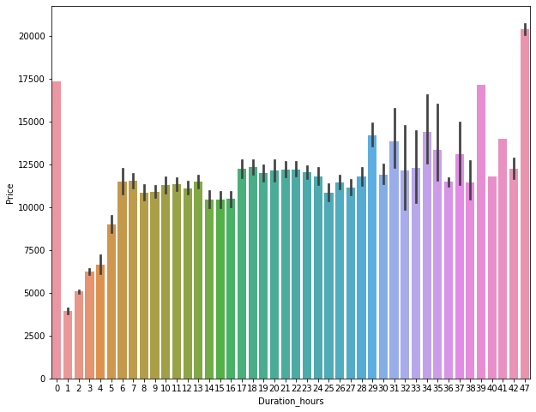
5-Duration hours vs price
Obs-
1-There is a pattern of increase in prices with respect to the hours.
2- But some Journeys which are quick and lesser than 1 hours are also having high prices, this shows that prices does no directly depends upon journey hours.

Slide 10
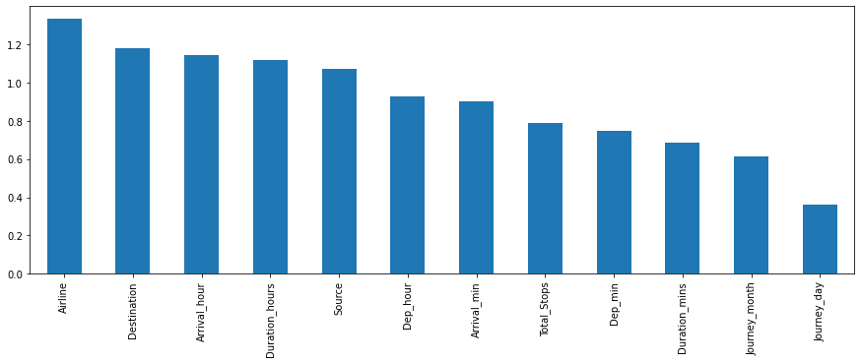
6- Important Features for Price Prediction
Obs-
1- This histogram shows, in descending order, the importance of features in Price Prediction.
2- most important features are Airline, Destination, Arrival Hour respectively
3- Least important features- journey day, journey month, destination mins respectively.

Slide 11
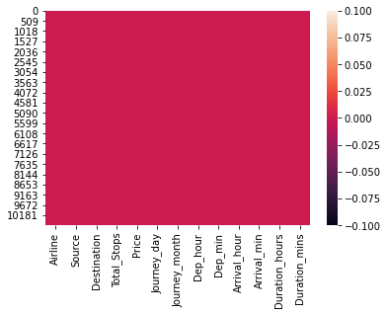
Working on Training and Testing set
1- finding the null values on the training set.
2- filling the null values, with mean in numerical columns and,with mode in categorical columns.
3-Eliminaing the columns having more than 70% null values
4-
Heatmap showing, no null values in the training dataset.

Slide 12
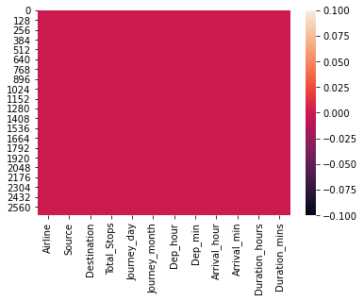
5- performing the same feature engineering steps in testing data set.
6-
Heatmap showing , no null values present in the testing dataset.
7- Joining both the training and testing datasets.
8- Encoding using, Ordinal Encoder, for encoding the categorical columns in the d(train+test) set.
9-Again splitting the two sets, using iloc method, into d_trainset and d_testset
10- Using the Variance Threshold method to find out the feature having only same response,(i.e- Utilities) and removing it from both d_trainset and d_testset

Slide 13

11- Dropping columns based on correlation using Mutual Info (But no columns were droped).
12- Now separating x(feature) and y(target) variable from the d_trainset.
13- finding out the most contributing feature towards the targe variable and removing the least contributing feature from d_testset and d_trainset.(i.e-

Slide 14
Obs-
1- This histogram shows, in descending order, the importance of features in Price Prediction.
2- most important features are Airline, Destination, Arrival Hour respectively
3- Least important features- journey day, journey month, destination mins respectively.

Slide 15
Model Selection
1-After selecting the x and y variable,we then perform the train_test_split and and check the training and testing in various models.
2-Models used – LinearRegression, DecisiontreeRegressor, KNeighborsRegressor, SVR, RandomForestRegressor, AdaBoostRegressor, GradientBoostRegressor,
3-Train_test_split was used to find out the accuracy of each model.
4-After this cross_val_score of each model was calculated.
5-By compairing the accuracy score with cross_val_score, RandomForestRegressor was found to be most efficient model.
6-After this Hypertest tuning was done through GridSearchCv to find out the best parameter for RandomForestRegressor .

Slide 16
Limitations
1-RandomForestRegressor is working with 92% accuracy.
2-There is a margin of 8% error in the predicted values.

Slide 17
Thank you
Submitted by- Akashdeep Singh Manral
Batch- 1834

